Slide 1
Electronic Records Management
Kenrie Hylton
Office of Archives Statistics & Research
General Conference of Seventh-day Adventists

Slide 2
ELECTRONIC RECORDS MANAGEMENT
Documents
Email
Digital Media
Notes:
Digital assets are digital content files, such as photographic images, audio, video, graphics, text files, or data. They may be stored locally on a server, digital device (PC, tablet, media player, etc.), or in the cloud.
Digital asset management, or DAM, is the process by which a person or organization categorizes, stores, and shares its digital assets. A DAM system is a software solution that facilitates and automates the DAM process.

Slide 3
e-mail policy & usage guide

Slide 4
Who owns the Email you compose from an organization Email address? (E.G. ekings@wad.adventist.org)
You (The Employee)
The Organization
Both

Slide 5
Use organizational email system
Email is owned by the organization, not the employee
Employees should be reminded that no automatic right of privacy applies to organizational emails
Once an employee leaves the organization, his/her mailbox will be preserved electronically

Slide 6
Use organizational email system
All work-related email should be generated within the organizational email system
Emails relating to personal matters should NOT be written using organizational email

Slide 7
Do not use cloud based email systems

Slide 8
Do not use cloud based email systems
What happens to your Cloud Based Email (Gmail, Hotmail, Yahoo etc.) if something happens to you?
Can your assistant access your cloud based email?
Use Cloud Based Email ONLY for Personal Use OR as a Backup in case the Email server is down
Notes:
What happens if you are out of email contact & a vital issue arises regarding previous email correspondence
If you need to use personal email in case the server is down, copy yourself on the email.

Slide 9
Records to Keep
Correspondence dealing with policies, administration, personnel, projects and statistics
Final travel schedules, including speaking and meeting appointments

Slide 10
Records to Keep
Emails relating to core organization practices
Records of meetings - emails that summarize meetings between individuals, or of ad hoc “working groups”, should be kept
Notes:
Committee minutes should not be prepared in email form , even if they are sent out by email as attached files.
However, sometimes important meetings between individuals, small groups and/or informal “working groups” might be summarised in emails—these are minutes, in effect, and need to be preserved.
These can continue to be stored in employees’ personal files, unless and until they relate to “key business processes” (see next slide)
—committee and board minutes should not be recorded in email form, even if they are shared via email, but

Slide 11
Records to Delete
Routine requests for materials
Generic circulars (e.g. newsletters from other offices)
Travel planning
Only final itinerary is necessary
Temporary financial records
Notes:
Routine requests – for catalogs, brochures, services, etc (unless context lends unusual significance)
Generic circular memos from other offices
Correspondence concerning travel planning
Non-SDA reports articles or other material (as .pdfs, .doc or .ppt files, or whatever)
Temporary financial records – phone bills, purchase orders, monthly financial statements

Slide 12
Records to Delete
Non-SDA related reports, articles, and other material
Routine Social Interactions or Emails about Scheduling
“Are you free for lunch at 1.15 or 1.30?”, “I need to change our meeting to Wednesday”, etc.
Emails of a personal nature
Notes:
Routine requests – for catalogs, brochures, services, etc (unless context lends unusual significance)
Generic circular memos from other offices
Correspondence concerning travel planning
Non-SDA reports articles or other material (as .pdfs, .doc or .ppt files, or whatever)
Temporary financial records – phone bills, purchase orders, monthly financial statements

Slide 13
Priorities for Preservation
Think of the archiving as the corporate memory. And treat emails like letters…
So, you should make sure you save emails:
portraying beginnings, changes, endings
dealing with cases, events, problems, or projects, which highlight the purpose and function of the organization
documenting its relationship with other denominational organizations
Notes:
Think of the archiving as the corporate memory. And treat emails like letters…
So, you should make sure you save emails:
portraying beginnings, changes, endings
dealing with cases, events, problems, or projects, which highlight the purpose and function of the organization
documenting its relationship with other denominational organizations

Slide 14
Other guidelines
Properly use the CC and BCC fields when sending Email
Avoid using CC to large groups
Use “Reply to All” only in cases where appropriate
Use Folders to Organize Email
Examples: Conferences, Travel, Meetings, ADCOM
Do NOT click on links from unfamiliar senders
Notes:
Avoid using “cc” except for emails to small groups; for larger groups (incl. emails to members of executive committees, ADCOMs and boards) should use “bcc”

Slide 15
Methods to Promote Email Policy & Guidelines
Schedule Periodic Staff Training
Include in New Employee Orientation Material & Training
Include in Employee Handbook
Launch Awareness Campaign

Slide 16
Media Records (Digital Photos/ Audio/ Video)

Slide 17
TYPES OF DIGITAL MEDIA ASSETS
Digital Photos
Audio
Video
Notes:
Digital assets are digital content files, such as photographic images, audio, video, graphics, text files, or data. They may be stored locally on a server, digital device (PC, tablet, media player, etc.), or in the cloud.
Digital asset management, or DAM, is the process by which a person or organization categorizes, stores, and shares its digital assets. A DAM system is a software solution that facilitates and automates the DAM process.

Slide 18
Media Asset Organization Process
Audit
Review non digitized holdings to determine what you have
Selection
Determine what to do with what you have
What should be digitized, what should be stored or tossed
Digitization
Digitize the media holdings that have been so designated
Storage
Aptly store items in a determined physical location
Create a digital storage area and store digitized content in this allocated space
Establish metadata standards, and enter metadata
Notes:
Content yet to be digitized
Audit can be long and difficult, but the benefits are significant
May choose to itemize each asset, which would be great – but keeping things simple and grouping by collections may be best

Slide 19
Media Asset Organization Process
DIGITIZE
SCAN
AUDIT
PROCESSING
DIGITAL STORAGE
STORE
TOSS
PHYSICAL STORAGE
TRASH
Notes:
My focus for the rest of the presentation will be on what comes next

Slide 20
STEPS TO IMPLEMENTING A DIGITAL ASSET MANAGEMENT SYSTEM
Audit Existing Digital Collection
Determine Needs
Review & Select Software
Implementation
Notes:
Conduct a content audit of all digital assets

Slide 21
AUDIT EXISTING COLLECTION
Conduct a thorough content audit of digital assets
How many files do you have?
How much digital storage space do they use?
What types of files do you have?
Where are the files stored?
Who needs access?
Notes:
Before you can look for a solution, you need to have an understanding of the problem or the extent of the challenge you intend to address
Easier than audit of physical files

Slide 22
AUDIT EXISTING COLLECTION
Media Type | File Type | Number of Files | Total File Size
Photo | TIFF | 1000 | 200 GB
Photo | JPG | 1400 | 20 GB
Photo | PNG | 800 | 30 GB
Video | MKV | 27 | 270 GB
Audio | MP3 | 85 | 300 MB
Location
P:\Photos C:\Documents\Pictures D:\Photo Collection C:\Documents\Ellen White Photos C:\Backup\Adventist_Images D:\Sermons
User | Collection | Access Type
James White | All | Full Access
Benjamin Franklin | Ellen White Collection Adventist Buildings | Read Only Read Only
Rebekah Moore | Audio Collection | Full Access
Notes:
Before you can look for a solution, you need to have an understanding of the problem or the extent of the challenge you intend to address
Easier than audit of physical files

Slide 23
DETERMINE NEEDS
Estimate Digital Storage Space Needs
Prepare a list of Requirements for Software
What functions are essential?
What additional features would be desired?

Slide 24
How much digital storage space will you need?
DETERMINE NEEDS
How much digital storage is currently being used?
How much more will be needed for future additions?

Slide 25
Photo File Size Estimates
300 DPI PRINT SCANS:
 | Pixel Dimensions | JPEG File Size | TIFF File Size
3 X 5 | 900 x 1500 | 650 KB - 1 MB | 3.9 MB
4 X 6 | 1200 x 1800 | 1.1 MB - 1.6 MB | 6.3 MB
5 X 7 | 1500 x 2100 | 1.6 MB - 2.3 MB | 9.2 MB
8 X 10 | 2400 x 3000 | 3.2 - 4.5 MB | 21.2 MB
Approximately 85GB for every 1,000 photos (600dpi 8 x 10)
600 DPI PRINT SCANS:
 | Pixel Dimensions | JPEG File Size | TIFF File Size
3 X 5 | 1800 x 3000 | 2.4 MB - 3.5 MB | 15.8 MB
4 X 6 | 2400 x 3600 | 3.6 MB - 5.2 MB | 25.3 MB
5 X 7 | 3000 x 4200 | 4.8 MB - 6.9 MB | 36.9 MB
8 X 10 | 4800 x 6000 | 9.1 MB - 14.3 MB | 84.4 MB
Video varies by format and compression (2GB – 1TB per hour of video)

Slide 26
Sample Requirements for Digital asset management system
Must Haves
Would Like
Metadata Management
Embed Metadata Within Photos
Facilitates Multiple Users over Network
Filtered Search
Batch Editing of Properties
Batch Rename
Manage Audio/Video Files
Security/Permissions
Broad File Format Support
Categorization
Watermarking
Image Editing Tools
Multiple Catalogs
Keyword Search
Social Media Sharing
Website Gallery Publishing

Slide 27
REVIEW & SELECT SOFTWARE
Considerations When Selecting a Digital Asset Management System
Methods of Inputting Metadata
Ability to Scale (Assets and Users)
Customizable
Grouping & Cataloging Options
Interoperability with Other Systems
Audio/Video Management Capabilities
Notes:
Evaluate Metadata Input Methods. User adoption of a DAM system depends on metadata entry.
Ability to Scale.
Consider the Degree of System Customization. Flexible enough to meet the needs of your users. Understand how simple or complex it will be to configure the DAM (custom code or toggle settings)
Determine Cataloging Capabilities. should be able to present assets in catalogs that are curated for specific users.
Make Sure it Can Integrate with Other Systems

Slide 28
Considerations When Selecting a Digital Asset Management System
REVIEW & SELECT SOFTWARE
Search Functionality
Assets only useful if you can find them
Explore search filters and advanced searching features
Security & Permissions
Developer Track Record
Customer Support
Notes:
Evaluate Asset Search Sophistication.
The assets in a digital asset management system are only useful if you can find them.
Strong DAM systems have many search filters and advanced ones are bringing in new and sophisticated search techniques and technologies.
Scope Out Permissions. Making assets only available to those who need them. Permissions should be available at catalog, group and even individual asset levels.
Verify Security Features. Keep your assets safe Investigate Vendor Track Record. Go with a trusted vendor with an established DAM platform
Assess Customer Support. Vendor who will support your system with true customer care and dedicated support staff. DAM is an ongoing program, not just an installation.

Slide 29
Adobe Bridge
Pros & Additional Features
Provides extensive metadata fields that extend beyond photos and includes general media management. Allows users to create Metadata Templates Very Robust and Flexible “Batch Rename” functionality Create and Save Custom Workspaces (User Interfaces) Free (for now)
Cons
Does NOT facilitate user permissions and access restrictions Collections are local only and not accessible by other users over a network

Slide 30
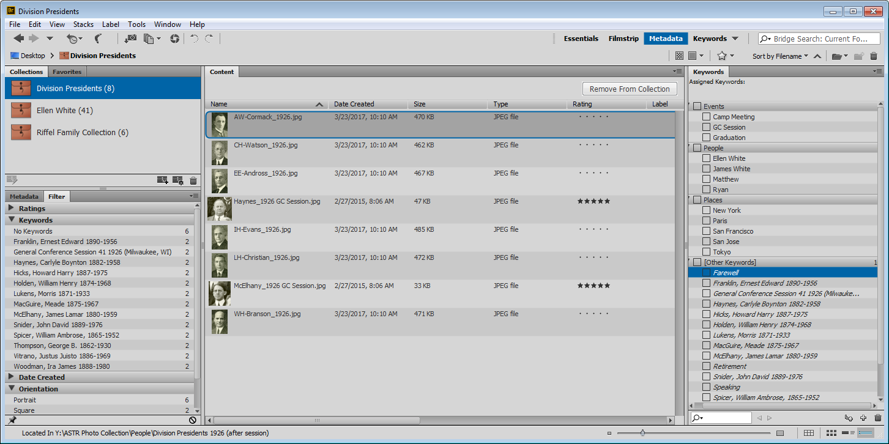
Adobe Bridge

Slide 31
QUESTIONS

Slide 32
Email Management
Importance
Management Tools and Methods
Training & Awareness Initiatives
Recommendations

Slide 33
Considerations for Successful Management of Email Records
Policies
Systems
Access
Disposition

Slide 34
Policies
Policies and training programs should explain staff responsibilities for managing email records.
The policies and training should instruct staff how to distinguish between permanent, temporary, transitory, and non-record email messages.

Slide 35
Systems
Systems should be in place that can manage, and preserve email records in an acceptable electronic format until disposition.

Slide 36
Access
Email records should remain discoverable, retrievable, and usable throughout their lifecycle.
Safeguards against unauthorized loss or destruction should be in place

Slide 37
Disposition
Appropriate retention periods for email records should be established
Systems should be implemented to support the appropriate disposition of email records according to the retention schedule.

Slide 38
Management Tools and Methods

Slide 39
Laserfiche and Microsoft Outlook

Slide 40
Adobe PDF and Microsoft Outlook

Slide 41
Microsoft Outlook AutoArchive Settings

Slide 42
Microsoft Outlook Retention Policy Settings

Slide 43
Important Points
Folders will need to be created to which users will move email into for archiving.
Emails are exported to a PST file.
Outlook 2016 for Mac does not have this feature, but files can be exported manually to an OLM file.
This will not require the installation or purchase of any additional software if Microsoft Outlook is already deployed.
The archived files may be imported into a Laserfiche repository for further management

Slide 44
Training & Awareness Initiatives
Developing documentation that provide guidelines and raise awareness regarding proper email management.
Include guidelines in new workers orientation
Reminders in the organization’s newsletter or other internal communication medium if available
A training video produced to demonstrate the process
Formal training sessions organized through the relevant department
General awareness discussion with departments during retention schedule updates

Slide 45
QUESTIONS

